Slide 1
National Polytechnic School Distributed Computing RMI vs. RPC BRED Solutions

Slide 2
Overview - RPC - RMI - Comparison between RPC and RMI - Problem analysis - Solution Design - Services Sequence and Arguments - Demonstration

Slide 3
Remote Procedure Call (RPC)
RPC is used to request a service from a program of a remote computer through the network.
It is the core of many Distributed Systems.
It just supports procedural programming.
It uses a stub in the client and a skeleton in the server.
It follows a requires/response protocol between the client and server.
Examples: SUN RPC and DCE RPC

Slide 4
Remote Method Invocation (RMI)
RMI is the evolution of RPC.
It supports RPC plus object-oriented programming.
It invokes a local method of another process.
Client/Server are represented as objects and uses a binder in order to obtain a remote object reference.
RMI Systems like Corba, DCOM, Java RMI, etc.

Slide 5
RPC vs. RMI
 | RPC | RMI
Programming support | Procedural | Object-oriented
Parameters sent | Normal data | Objects
Version | Original | RPC’s Evolution
Overhead | High | Low
Language/Platform | Any | Java Platform

Slide 6
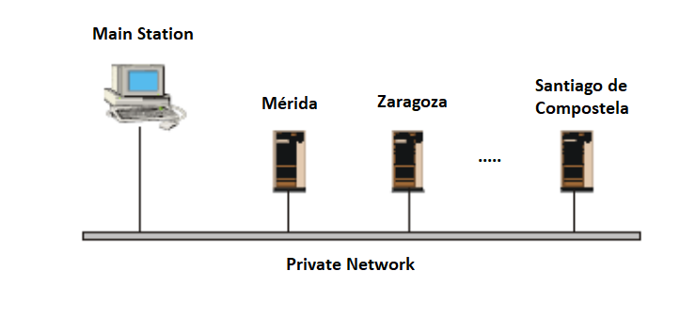
Problem analysis
A bank has a main computer (server) in Toledo and different users in each province (Seville, Merida, Zaragoza, Santiago de Compostela, etc.) who have a computer that allows remote access to the main computer data.

Slide 7

It is desired to implement, in each of the agencies, an access security system that works as follows:
The central station has the users' data (name, e-mail, telephone, password, balance). The system additionally stores the IP address of the last access.

Slide 8

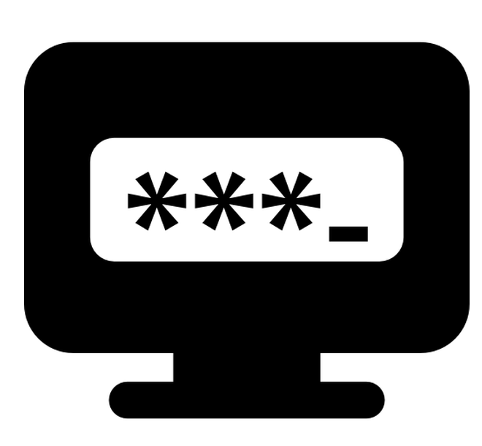
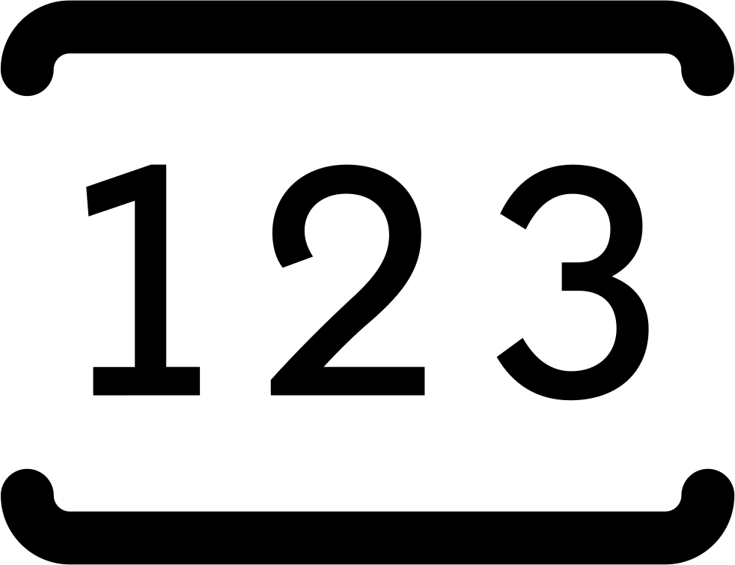

When a client attempts to connect for the first time from an unknown IP address, the system uses a double authentication procedure. If the password is correct, the system sends an email or an SMS with a verification code. Once verified, the IP address is saved, the client can access to the system where queries/payments can be made.

Slide 9
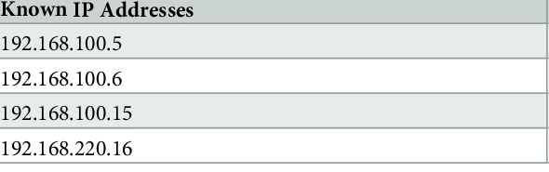
On later connections, if the IP address is not changed, the client can access to the system using only the password.

Slide 10
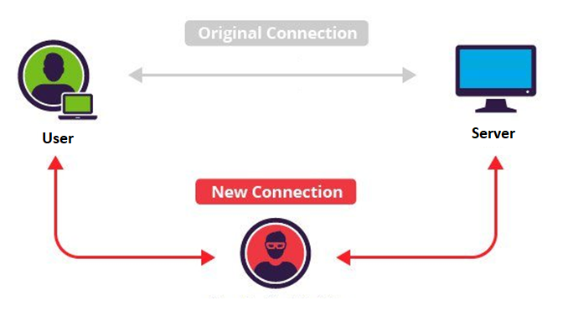

If a user A is using the system and another unknown user B knows the credentials and tries to connect from an unknown IP address, the system automatically blocks itself and sends a message to user A informing him of what happened, and asking him to change his credentials.

Slide 11
Solution Design

Slide 12
Services Sequence and Arguments

Slide 13
DEMONSTRATION

